Slide 1
Penetration on ColddBox
This project focuses on penetration testing of a ColddBox web application
Tools such as Nmap, Nikto, WPScan, OWASP ZAP, and Burp Suite were used
Vulnerabilities identified include SQL Injection, Cross-Site Scripting, and Session Fixation
Weak authentication was exploited to gain access to the WordPress dashboard
The project demonstrates the importance of securing applications against real-world cyber attacks.

Slide 2
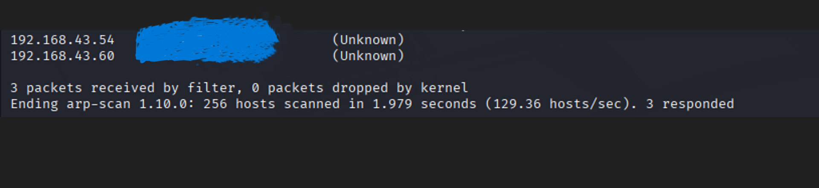
Network scan results show IP address[LAB_TARGET_IP]. The device status is unknown, indicating potential for further investigation. Using Sudo arp-scan command.

Slide 3
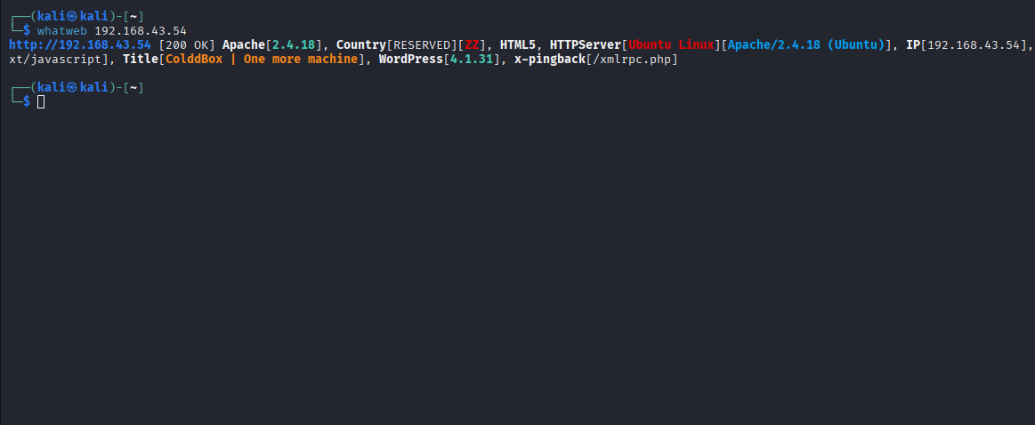
ColddBox is running on an Apache server (v2.4.10) at [LAB_TARGET_IP]. The system is Kali Linux, and there's a mention of WordPress v6.3.3.

Slide 4
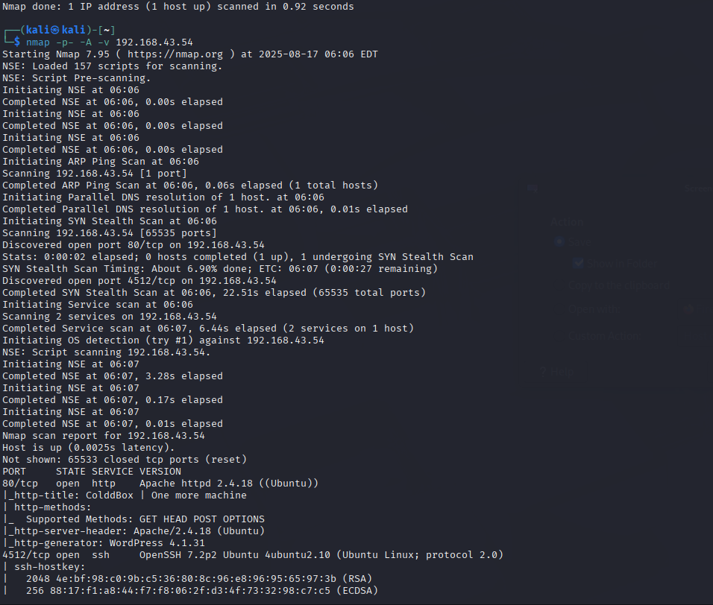
Nmap scan results showing [LAB_TARGET_IP]with ports 80/tcp open for Apache httpd 2.4.18 and 4512/tcp open for ssh with OpenSSH 7.2p2.

Slide 5
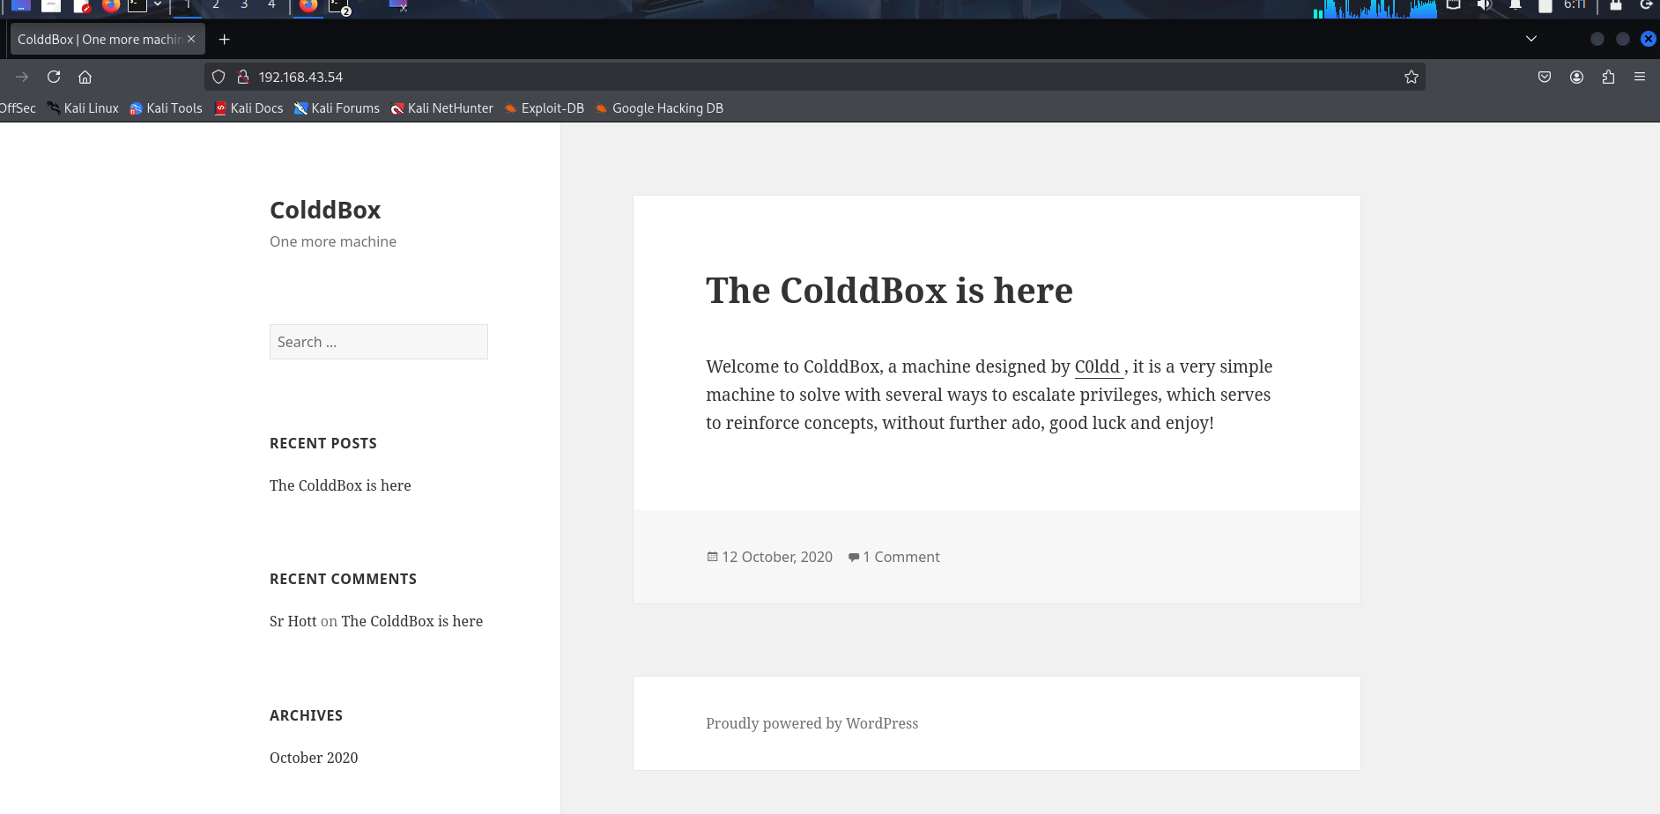
I identified port 80 is opened then it works with the browser. And I enter the target IP into the browser.

Slide 6
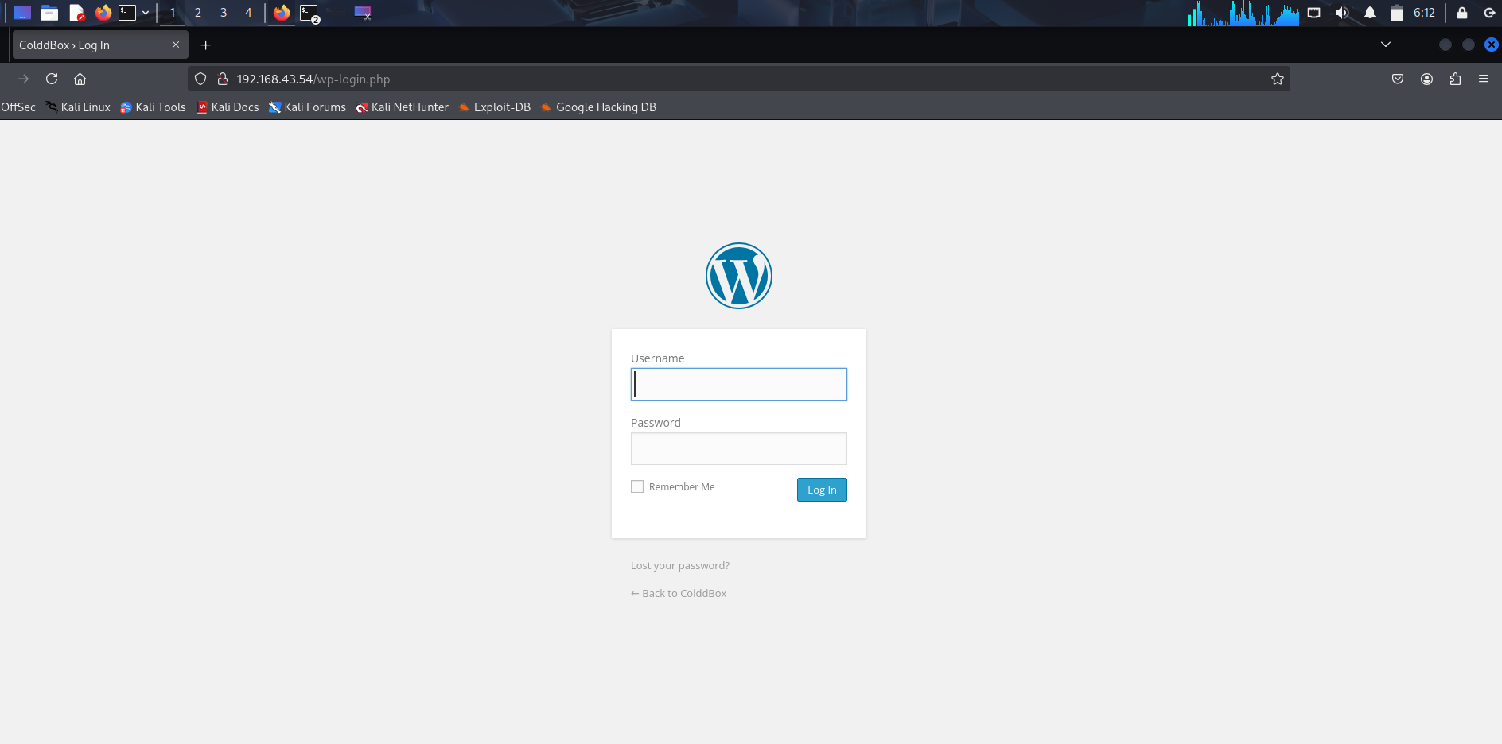
scroll down and I found this login page and I also found wordpress.org

Slide 7
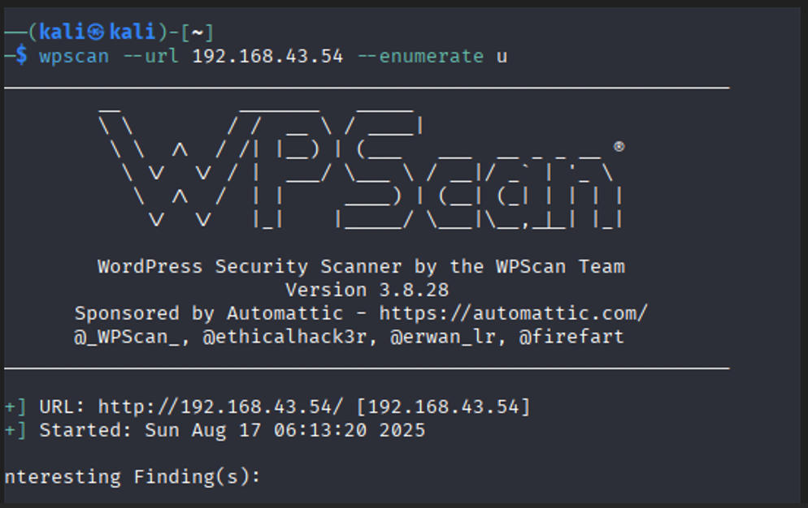
So now I used wpscan tool to find out the usernames and passwords for them. First I enumerate the usernames.

Slide 8
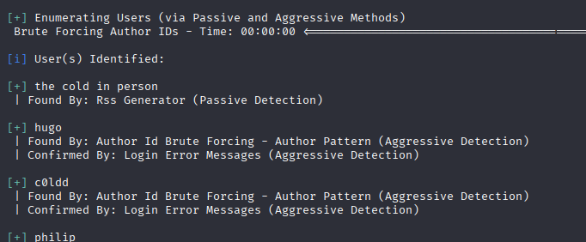
From this, I found there are several user names with this.

Slide 9
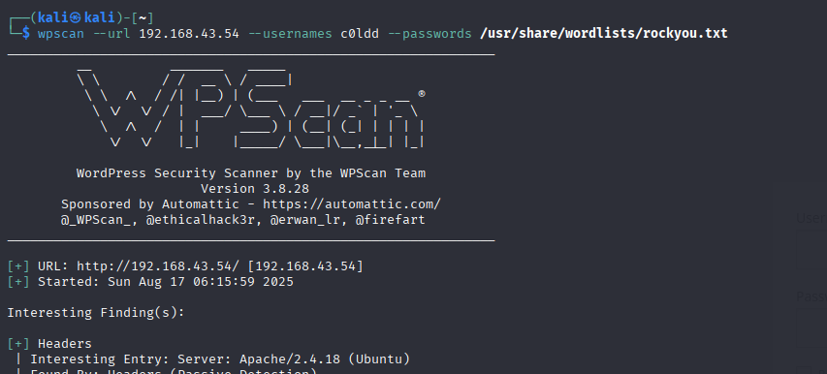
I chose the c0ldd username and I perform a command to find the password of it with wpscan.

Slide 10
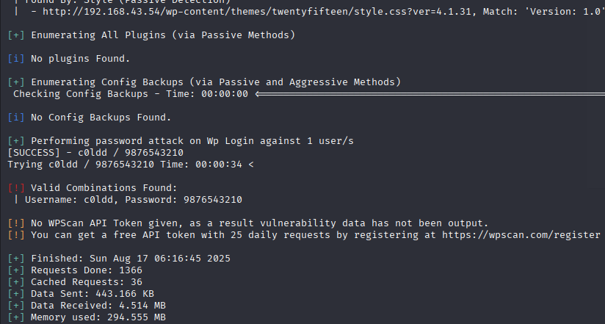
From this, A weak password was identified during authorized lab testing.

Slide 11
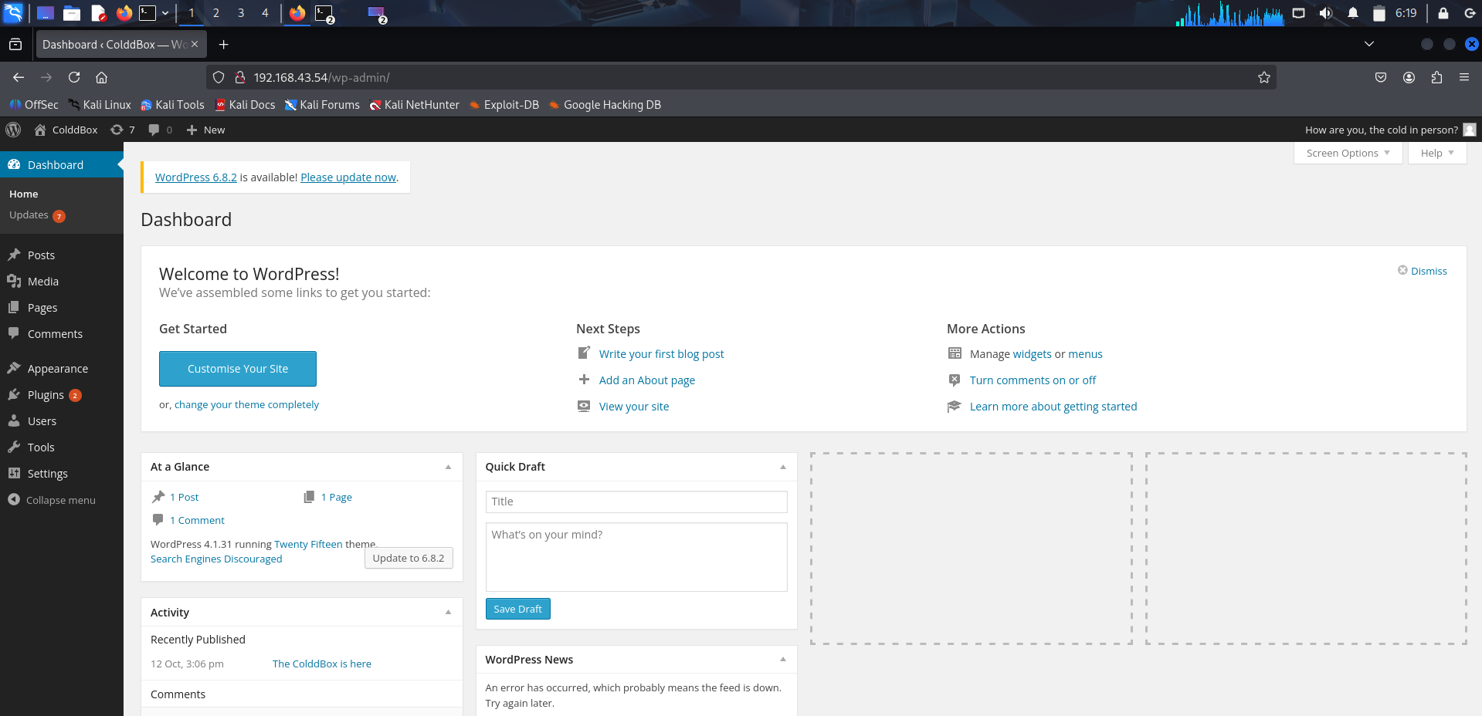
Cool, now I’m in the admin dashboard.

Slide 12
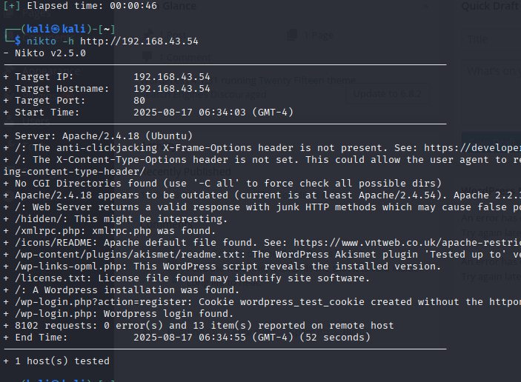
Next I will scan using Nikto

Slide 13
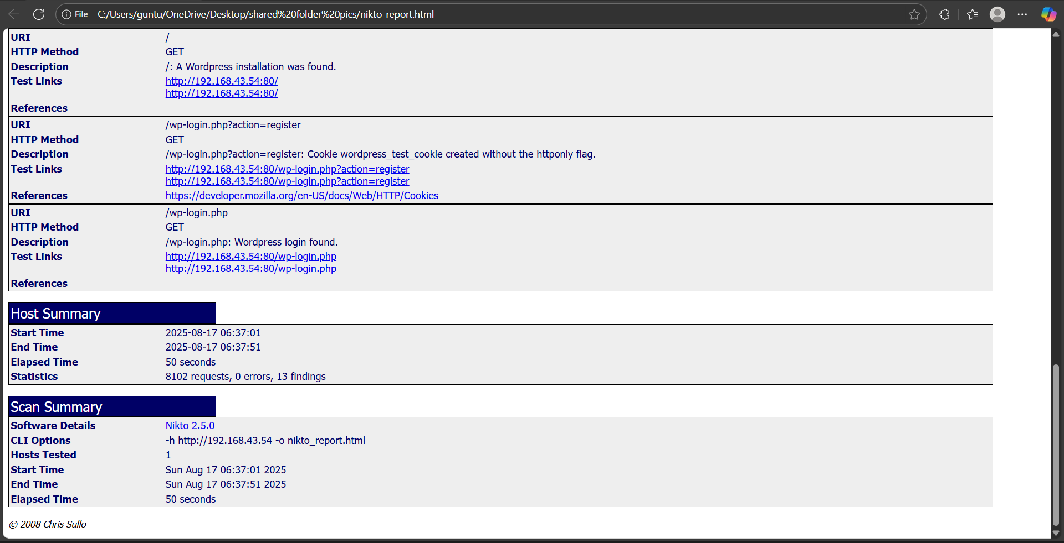
See nikto report here.

Slide 14
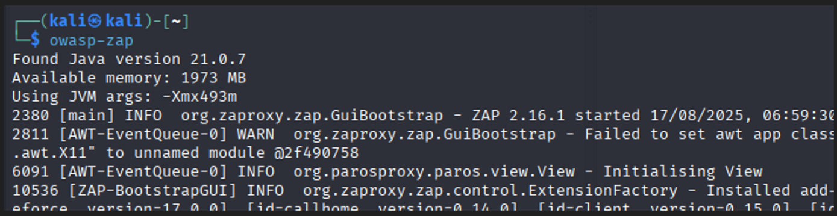
I will also use owasp-zap to scan.

Slide 15
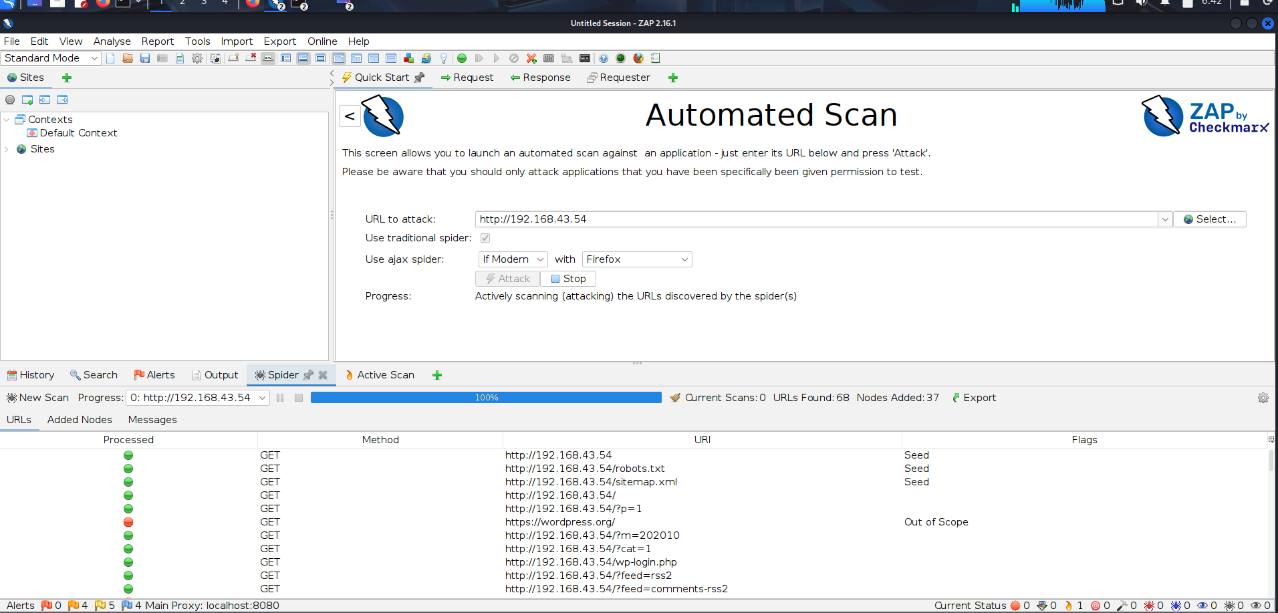
See here scanning is done.

Slide 16
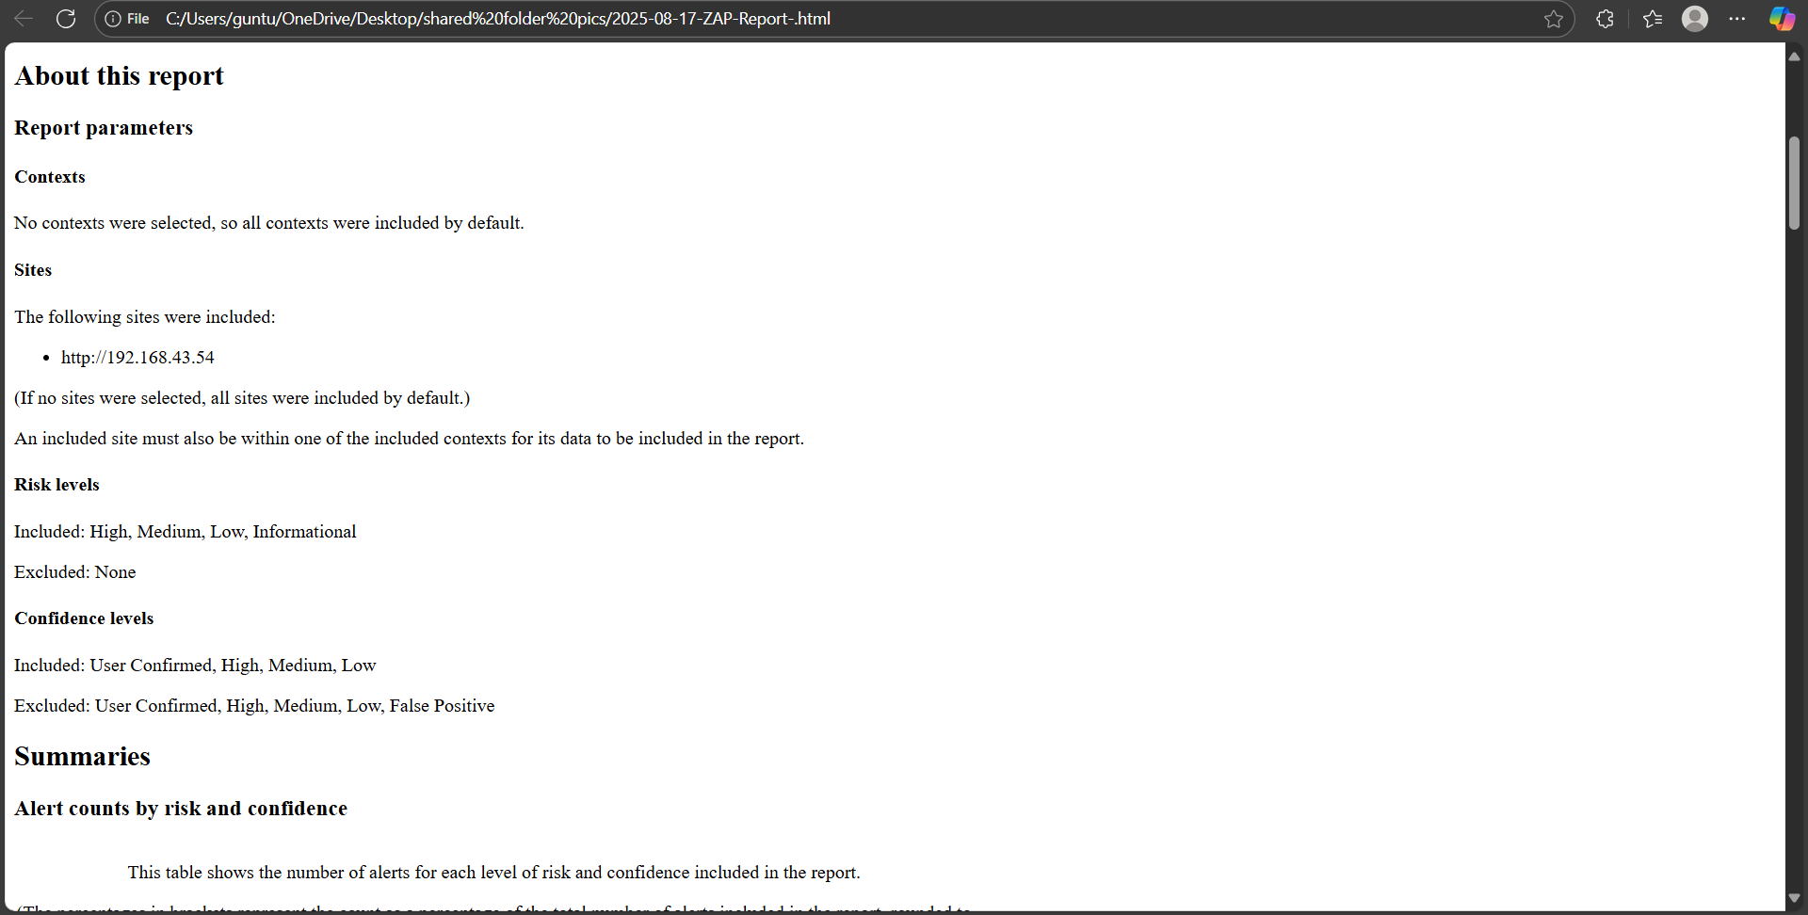
See zap report here.

Slide 17
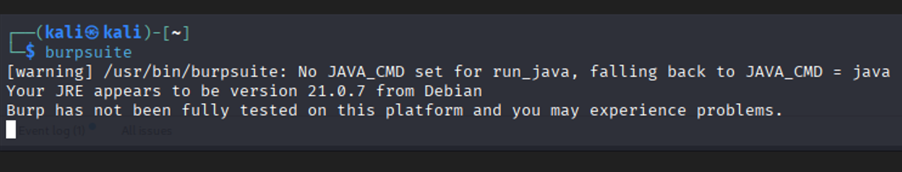
I will next step to burpsuite scan

Slide 18
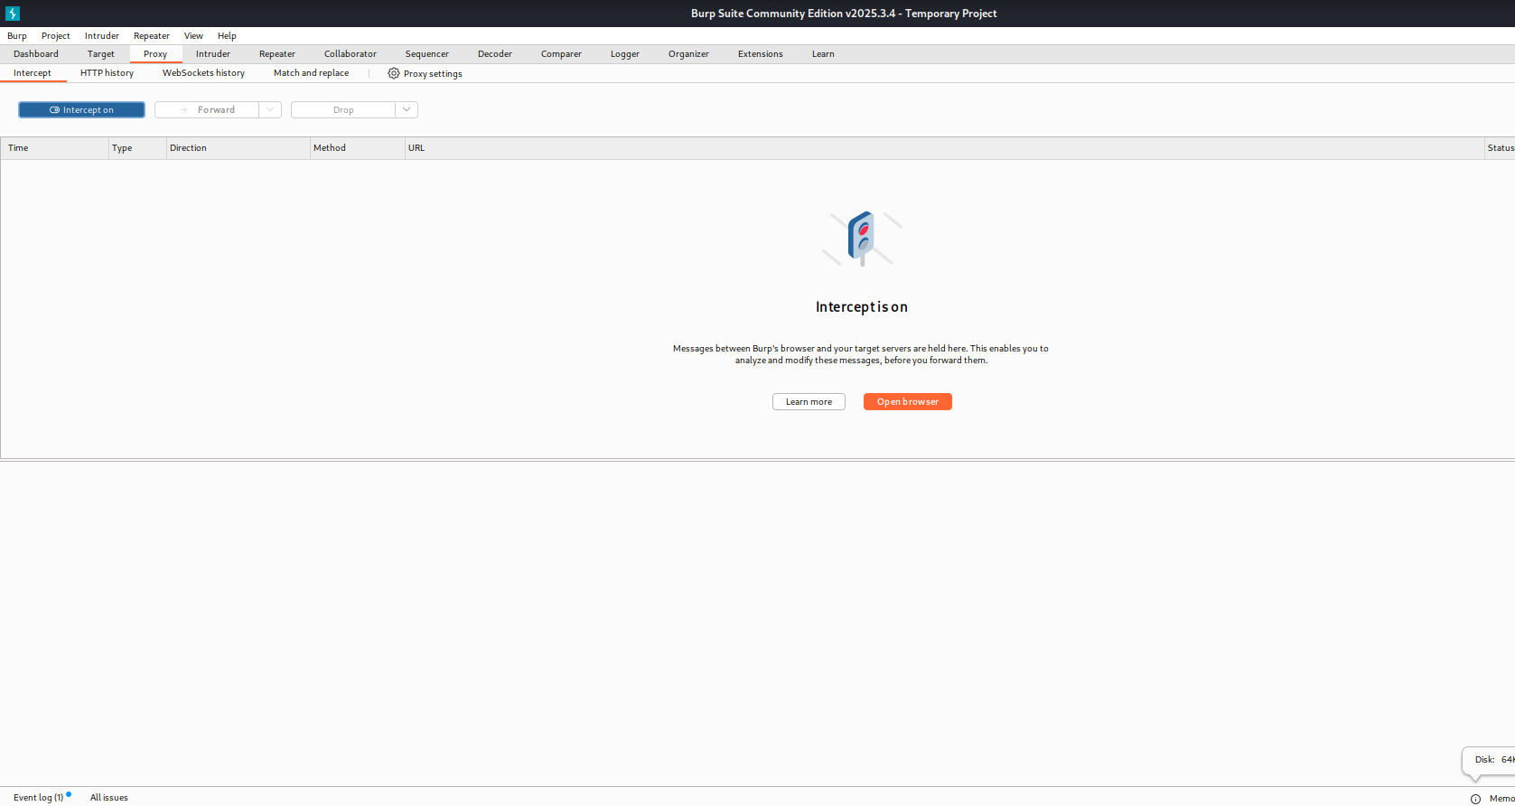
See here its performing

Slide 19
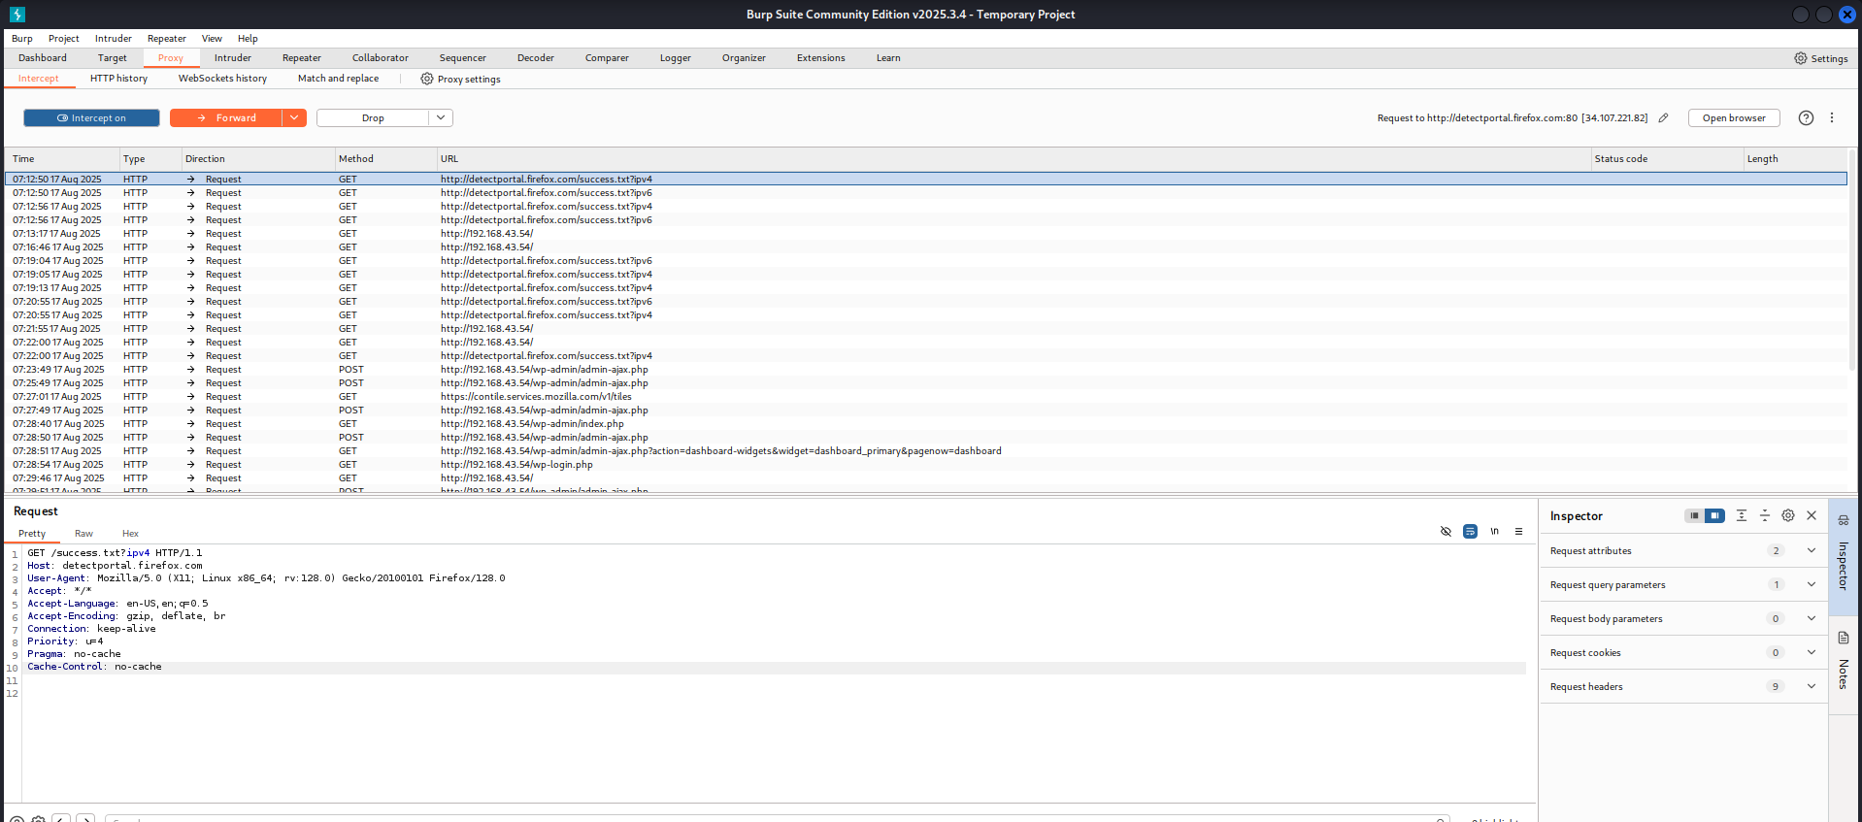
Scanning all in colddbox application.

Slide 20
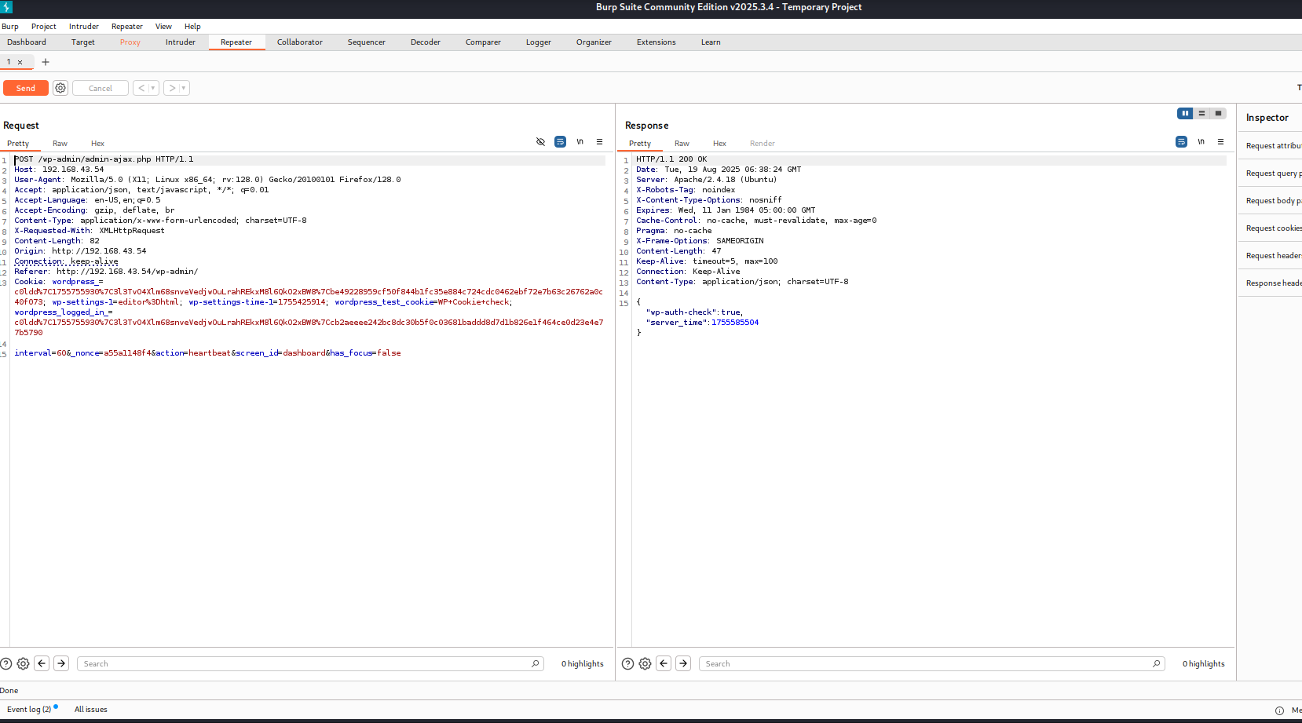
See here wordpress login and wordpress cookies and wordpress scan I see all related to that wp.

Slide 21
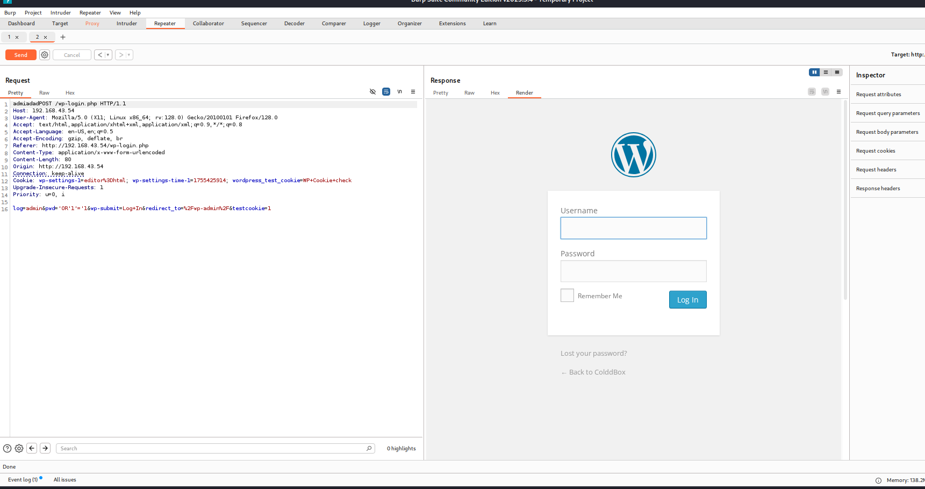
See request side it shows cookie ,login , pwds and also see a response side display login page of colddbox application.

Slide 22
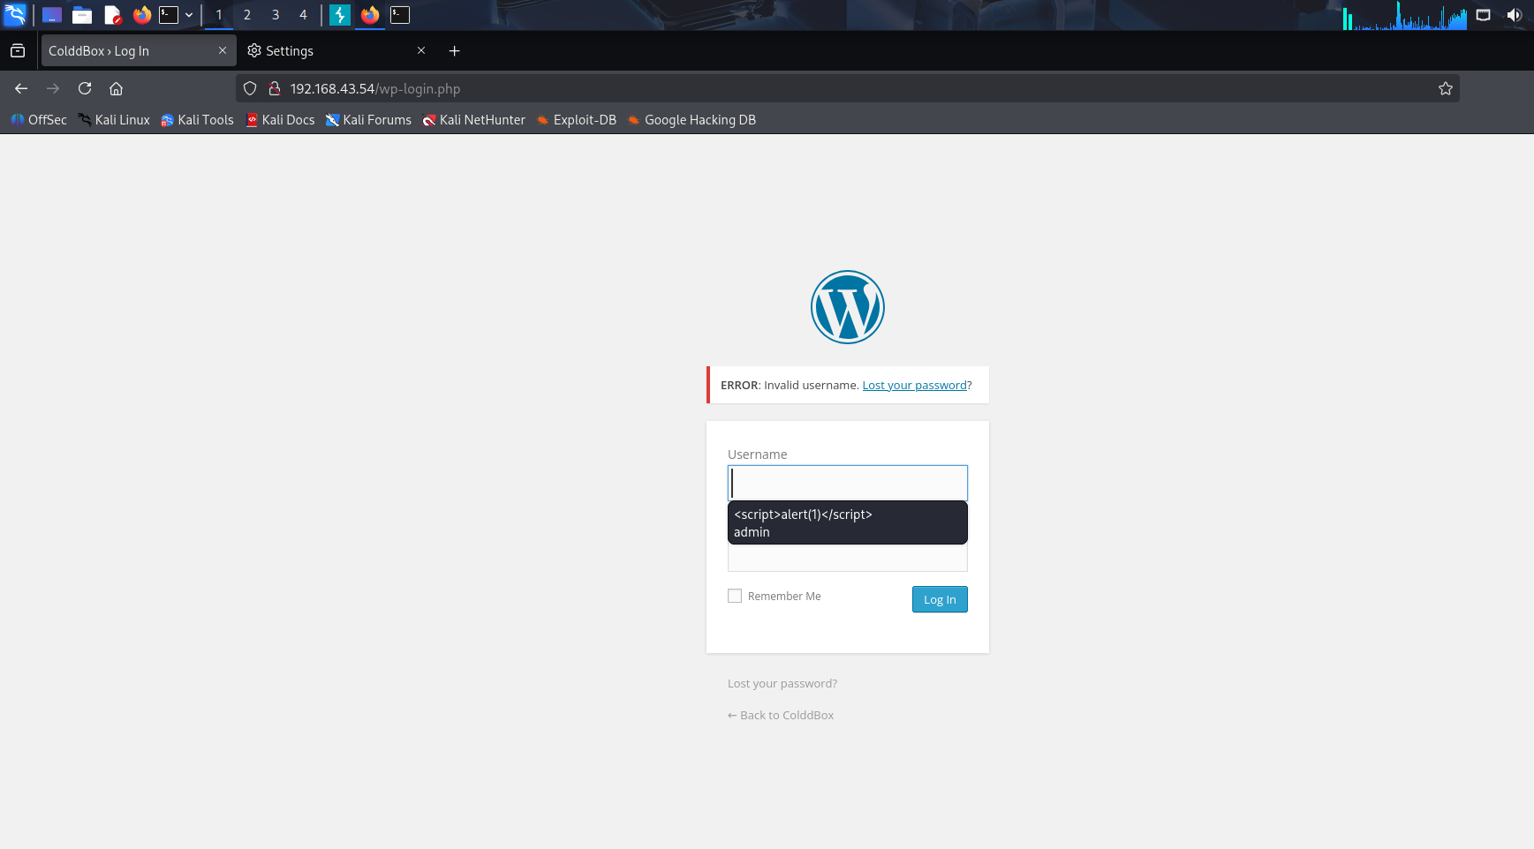
Penetration testing on the Colddbox application , Potential vulnerabilities investigated such as SQL Injection , XSS, Weak authentication, and Session fixation.

Slide 23
Conclusion:
Penetration testing on the ColddBox application revealed critical vulnerabilities like SQL Injection, XSS, session fixation, and weak authentication.
Tools used: Nmap, Nikto, WPScan, OWASP ZAP, and Burp Suite.
Exploitation allowed access to the WordPress dashboard and cookies analysis
Security recommendations were suggested to strengthen the application.
This project highlights the need for continuous web application security testing.

